Slide 1

David M. Kroenke and David J. Auer Database Processing: Fundamentals, Design, and Implementation
Chapter Eight:
Database Redesign

Slide 2
Chapter Objectives
To understand the need for database redesign
To be able to use correlated subqueries
To be able to use the SQL EXISTS and NOT EXISTS comparison operators in correlated subqueries
To understand reverse engineering
To be able to use dependency graphs
To be able to change table names
To be able to change table columns
To be able to change relationship cardinalities
To be able to change relationship properties
To be able to add and delete relationships

Slide 3
Need for Database Redesign
Database redesign is necessary:
To fix mistakes made during the initial database design.
To adapt the database to changes in system requirements.
Because information systems and organizations create each other, a new information system will cause changes in systems requirements:
When a new system is installed, users can behave in new ways.
As the users behave in the new ways, they will want changes to the system to accommodate their new behaviors.

Slide 4
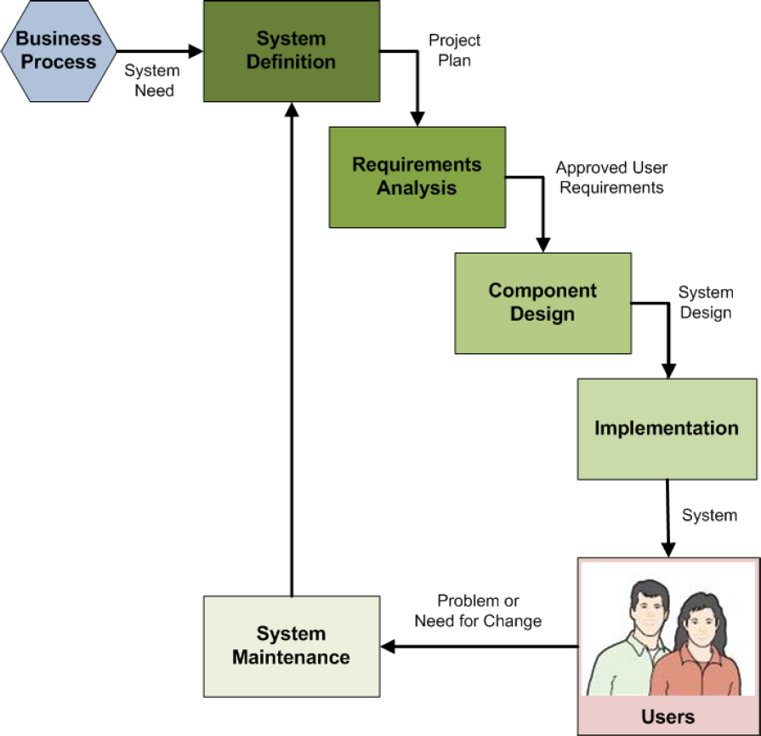
System Maintenance in the SDLC
The systems development life cycle (SDLC) as discussed in Appendix B
Database redesign is prompted during the system maintenance step of the SDLC, and which may start another iteration of the SDLC

Slide 5
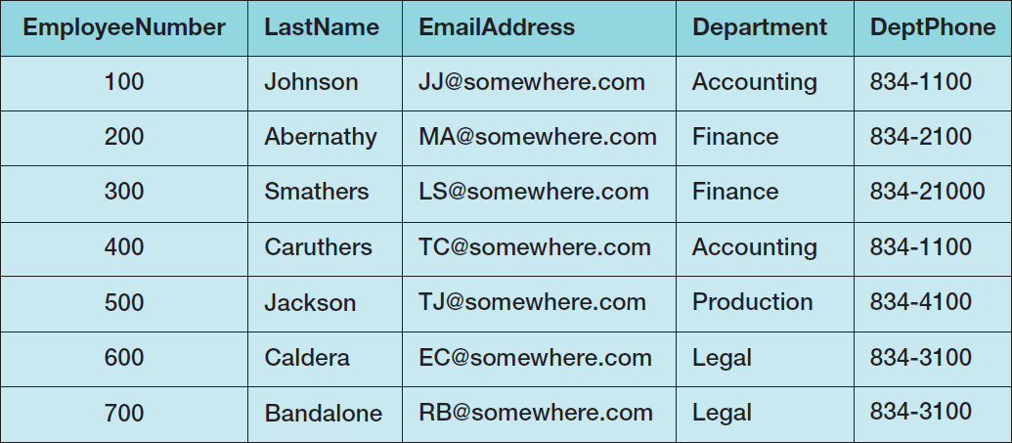
Table Showing Constraint Assumption Violation

Slide 6
Correlated Subqueries
A correlated subquery looks similar to a regular subquery.
A regular subquery can be processed from the bottom up.
For a correlated subquery, the processing is nested, i.e., a row from an upper query statement is used in comparison with rows in a lower-level query.

Slide 7
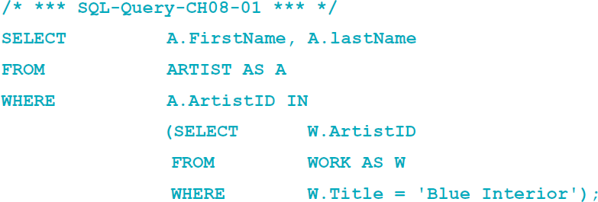
Non-Correlated Subquery
We used the following type of subquery in Chapter 2.
It contains two separate tables in the levels of the query.
ARTIST in the top level query
WORK in the subquery

Slide 8
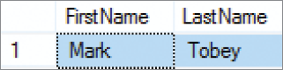
Non-Correlated Subquery Results

Slide 9
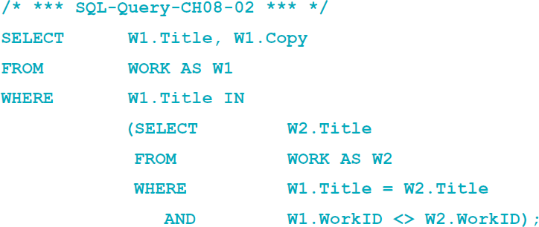
Correlated Subquery to Find Row with the Same Title
The following is a correlated subquery.
It contains the same tables in both levels of the query.

Slide 10
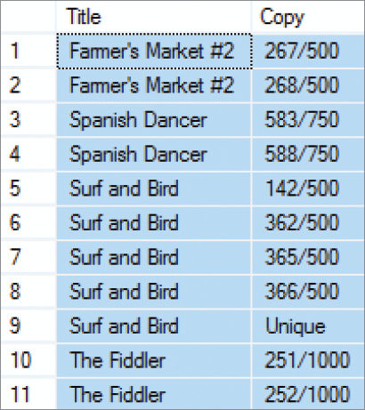
Correlated Subquery Results

Slide 11
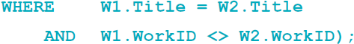
The Difference Between Regular and Correlated Subqueries
Notes:
In these expressions, W1.Title (from the top SELECT statement) is being compared with W2.Title (from the bottom SELECT statement). The same is true for W1.WorkID and W2.WorkID. Because of this fact, the DBMS cannot process the subquery portion independent of the upper SELECT.
Instead, the DBMS must process this statement as a subquery that is nested within the main query. The logic is as follows: Take the first row from W1. Using that row, evaluate the second query. To do that, for each row in W2, compare W1.Title with W2.Title and W1.WorkID with W2.WorkID. If the titles are equal and the values of WorkID are not equal, return the value of W2.Title to the upper query. Do this for every row in W2.
Once all of the rows in W2 have been evaluated for the first row in W1, move to the second row in W1 and evaluate it against all the rows in W2. Continue in this way until all rows of W1 have been compared with all of the rows of W2.

Slide 12
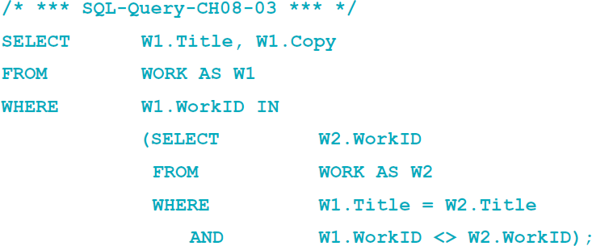

A Common Trap
Notes:
In fact, no row will ever be displayed by this query, regardless of the underlying data.
The bottom query will indeed find all rows that have the same title and different WorkIDs. If one is found, it will produce the W2.WorkID of that row. But that value will then be compared with W1.WorkID. These two values will always be different because of the condition
W1.WorkID <> W2.WorkID
No rows are returned because the values of the two unequal WorkIDs are used in the IN instead of the values of the two equal Titles.

Slide 13
The Problem Table

Slide 14
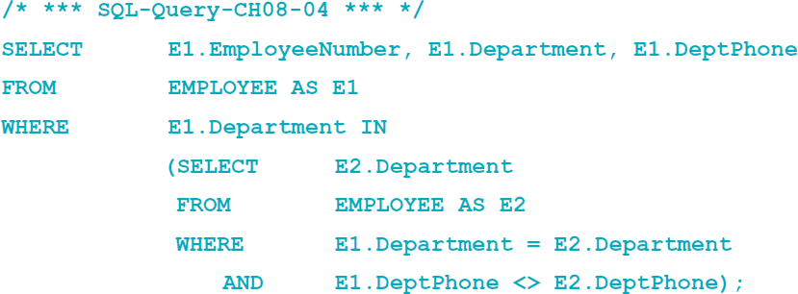
Checking Functional Dependencies
The following correlated subquery can be used to check for any rows that violate the functional dependency.
Department → DeptPhone

Slide 15
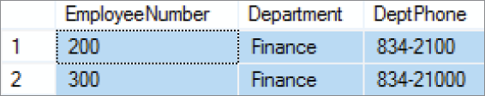
Checking Functional Dependencies Results

Slide 16
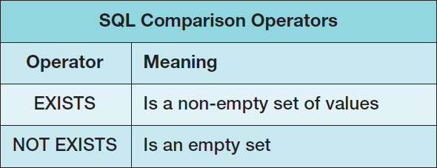
SQL EXISTS and NOT EXISTS Comparison Operators I

Slide 17
SQL EXISTS and NOT EXISTS Comparison Operators II
Using the SQLE XISTS comparison operator and the SQL NOT EXISTS comparison operator (both discussed in Chapter 2) we can create specialized forms of correlated subqueries.
An EXISTS condition is true if any row in the subquery meets the specified conditions.
A NOT EXISTS condition is true only if all rows in the subquery do not meet the specified condition.
The use of a double NOT EXISTS can be used to find rows that have some specified condition to every row of a table.

Slide 18
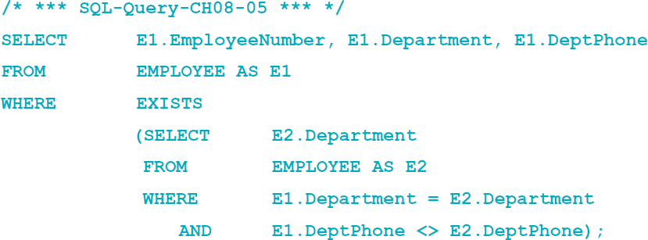
Checking Functional Dependencies
Here is the code to check the previous functional dependency using the SQL EXISTS comparison operator:

Slide 19
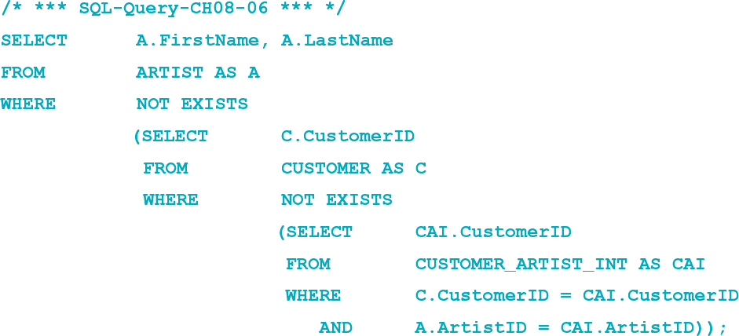
Double NOT EXISTS
The following code determines the name of any ARTIST that is of interest to every CUSTOMER:
Notes:
The doubly nested NOT EXISTS pattern is famous in one guise or another among SQL practitioners. It is often used as a test of SQL knowledge in job interviews and in bragging sessions, and it can be used to your advantage when assessing the desirability of certain database redesign possibilities, as you will see in the last section of this chapter. Therefore, even though this example involves some serious study, it is worth your while to understand it.

Slide 20

Double NOT EXISTS Results
Notes:
Let’s see how this works. The bottom SELECT (the third SELECT in the SQL statement) finds all of the customers who are interested in a particular artist. As you read this SELECT (the last SELECT in the query), keep in mind that this is a correlated subquery; this SELECT is nested inside the query on CUSTOMER, which is nested inside the query on ARTIST. C.CustomerID is coming from the SELECT on CUSTOMER in the middle, and A.ArtistID is coming from the SELECT on ARTIST at the top.
Now the NOT EXISTS in the sixth line of the query will find the customers who are not interested in the given artist. If all customers are interested in the given artist, the result of the middle SELECT will be null. If the result of the middle SELECT is null, the NOT EXISTS in the third line of the query will be true, and the name of that artist will be produced, just as we want. Consider what happens for artists who do not qualify in this query. Suppose that every customer except Tiffany Twilight is interested in the artist Joan Miro. (This is not the case for the data in Figure 7-15, but assume that it were true.) Now, for the preceding query, when Miro’s row is considered, the bottom SELECT will retrieve every customer except Tiffany Twilight. In this case, because of the NOT EXISTS in the sixth line of the query, the middle SELECT will produce the CustomerID for Tiffany Twilight (because her row is the only one that does not appear in the bottom SELECT). Now, because there is a result from the middle SELECT, the NOT EXISTS in the top SELECT is false, and the name Joan Miro will not be included in the output of the query. This is correct because there is a customer who is not interested in Joan Miro.

Slide 21
Database Redesign
Three principles for database redesign:
Measure twice and cut once: understand the current structure and contents of the database before making any structure changes.
Test the new changes on a test database before making real changes.
Create a complete backup of the operational database before making any structure changes.
Technique: Reverse Engineering (RE)

Slide 22
Reverse Engineering (RE)
Reverse engineering (RE) is the process of reading and producing a data model from a database schema.
A reverse engineered (RE) data model:
Provides a basis to begin the database redesign project.
Is neither truly a conceptual nor an internal schema as it has characteristics of both.
Should be carefully reviewed because it almost always has missing information.

Slide 23
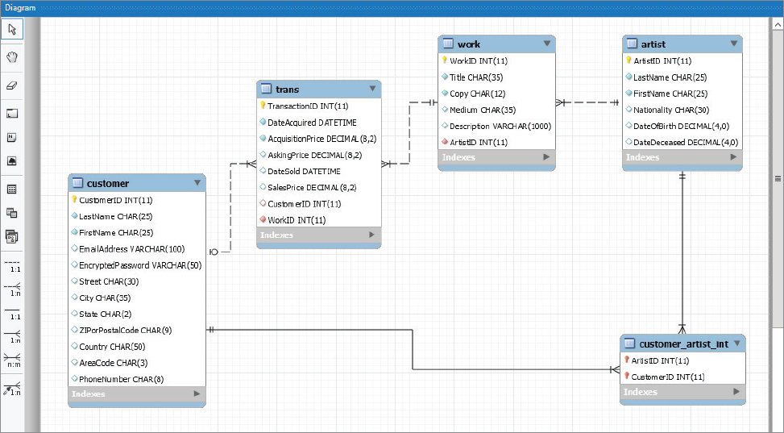
Reverse Engineered Data Model
Notes:
If you compare the VRG data model in Figure 6-37 and the VRG database design in Figure 6-39 to this VRG RE data model, you will see that the MySQL Workbench came close to duplicating the VRG database design rather than the VRG data model.
The MySQL Workbench:
■ Contains the final primary keys and foreign keys, rather than the data model entity indentifiers.
■ Contains the customer_artist_int table, rather than the N:M relationship between CUSTOMER and ARTIST shown in the data model.
■ Contains wrong minimum cardinality values. All of the many sides of the 1:N relation- ships should be optional except for the WORK-to-TRANS relationship, based on the VRG database design.
All in all, however, this is a reasonable representation of the View Ridge Gallery database design. For more information about using the MySQL Workbench, see Appendix E.

Slide 24
Dependency Graphs
Dependency graphs are diagrams used to portray the dependency of one element on another.

Slide 25
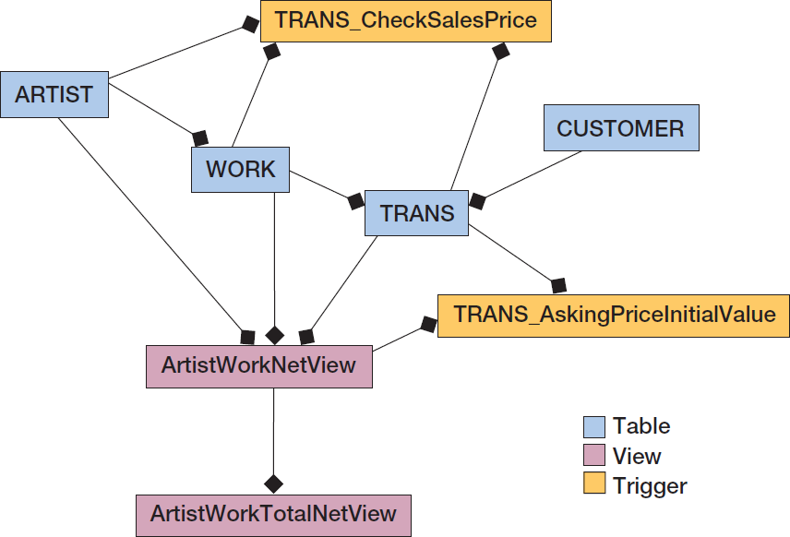
Composite Dependency Graph [Incomplete]

Slide 26
Database Backup and Test Databases
Before making any changes to an operational database:
A complete backup of the operational database should be made.
Any proposed changes should be thoroughly tested.
Three different copies of the database schema used in the redesign process:
A small test database for initial testing
A large test database for secondary testing
The operational database

Slide 27
Database Redesign Changes
Changing tables and columns
Changing table names
Adding and dropping table columns
Changing data type or constraints
Adding and dropping constraints
Changing relationships
Changing cardinalities
Adding and deleting relationships
Adding and removing relationships for denormalization

Slide 28
Changing Table Names
Although SQL or DBMS specific commands exist, there is no good command to change a table name except in the most simple cases.
The table needs to be re-created under the new name, tested, and the old table is dropped.
Changing a table name has a surprising number of potential consequences.
Therefore, using views defined as table aliases is more appropriate.
Only views that define the aliases would need to be changed when the source table name is changed.

Slide 29
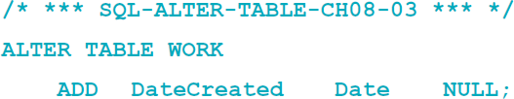
Adding Columns I
To add NULL columns to a table:

Slide 30
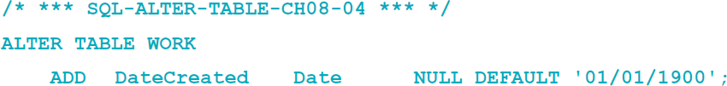
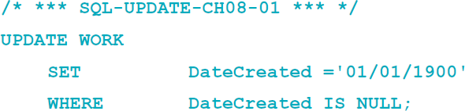
Adding Columns II
Other column constraints, e.g., DEFAULT or UNIQUE, may be included with the column definition.
Newly added DEFAULT constraint will be applied to only new rows, existing rows will have null values.

Slide 31
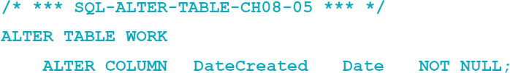
Adding Columns III
Three steps to add a NOT NULL column:
Add the column as NULL.
Add data to every row.
Alter the column constraint to NOT NULL.

Slide 32

Dropping Columns
To drop nonkey columns:
To drop a foreign key column, the foreign key constraint must first be dropped.
To drop the primary key, all foreign keys using the primary key must first be dropped; followed by dropping the primary key constraint.

Slide 33
Changing Data Type or Constraints
Use the SQL ALTER TABLE ALTER COLUMN statement to change data types and constraints.
For some changes, data will be lost or the DBMS may refuse the change.
To change a constraint from NULL to NOT NULL, all rows must have a value first.

Slide 34
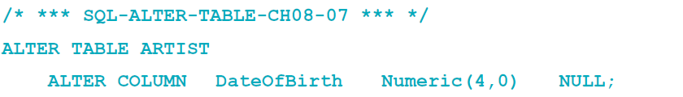
Changing Data Type or Constraints
Converting more specific data type, e.g., date, money, and numeric, to char or varchar will usually succeed.
Changing a data type from char or varchar to a more specific type can be a problem.
Example:

Slide 35
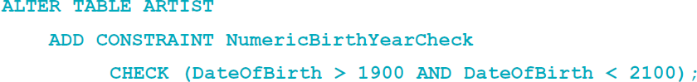
Adding and Dropping Constraints
Use the SQL ALTER TABLE ADD (DROP) CONSTRAINT statement to add (remove) constraints
Example

Slide 36
Changing Minimum Cardinalities
On the parent side:
To change from zero to one, change the foreign key constraint from NULL to NOT NULL.
Can only be done if all the rows in the table have a value.
To change from one to zero, change the foreign key constraint from NOT NULL to NULL.
On the child side:
Add (to change from zero to one) or drop (to change from one to zero) triggers that enforce the constraint.

Slide 37
Changing Maximum Cardinalities: 1:1 to 1:N
If the foreign key is in the correct table, remove the unique constraint on the foreign key column.
If the foreign key is in the wrong table, move the foreign key to the correct table and do not place a unique constraint on that table.

Slide 38
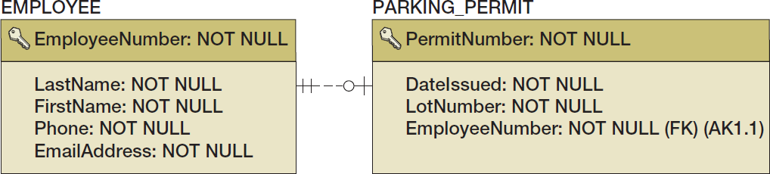
Changing Maximum Cardinalities: 1:1 to 1:N Example

Slide 39
Changing Maximum Cardinalities: 1:N to N:M
Build a new intersection table and move the key and foreign key values to the intersection table

Slide 40
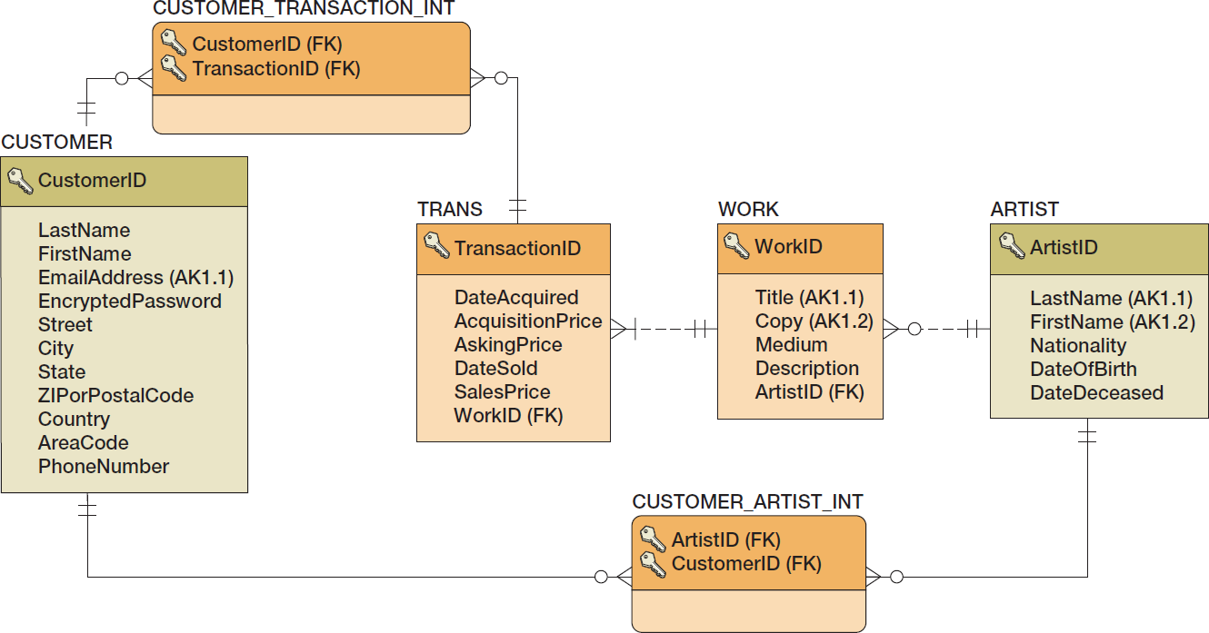
Changing Maximum Cardinalities: 1:N to N:M Example

Slide 41
Reducing Cardinalities
Reducing cardinalities may result in data loss.
Reducing N:M to 1:N:
Create a foreign key in the parent table and move one value from the intersection table into that foreign key.
Reducing 1:N to 1:1:
Remove any duplicates in the foreign key and then set a uniqueness constraint on that key.

Slide 42
Adding and Deleting Relationships
Adding new tables and relationships:
Add the tables and relationships using CREATE TABLE statements with FOREIGN KEY constraints.
If an existing table has a child relationship to the new table, add a FOREIGN KEY constraint using the existing table.
Deleting relationships and tables:
Drop the foreign key constraints and then drop the tables.

Slide 43
Forward Engineering
Forward engineering is the process of applying data model changes to an existing database.
Results of forward engineering should be tested before using it on an operational database.
Some tools will show the SQL that will execute during the forward engineering process:
If so, that SQL should be carefully reviewed.

Slide 44
David Kroenke and David Auer Database Processing Fundamentals, Design, and Implementation (14th Edition)
End of Presentation:
Chapter Eight

Slide 45

All rights reserved. No part of this publication may be reproduced, stored in a retrieval system, or transmitted, in any form or by any means, electronic, mechanical, photocopying, recording, or otherwise, without the prior written permission of the publisher. Printed in the United States of America.

